Slide 1
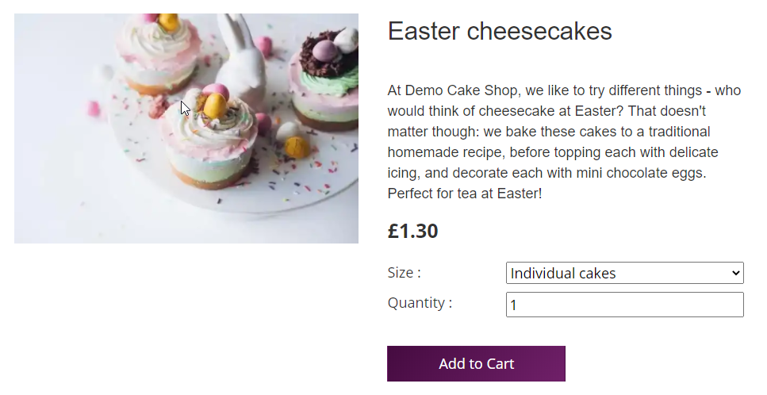
Product Gallery
All products are displayed in grid, using ProductGrid component
Gatsy-node.js traps each request & passes node.handle value to template
index.js Template used to display each product – stored in templates/ ProductPage folder
Intercepts requests
Pass value
Product Page
Queries Shopify based on slug and produces pages at build-time

